Slide 1

In
NYC

Slide 2

Group project
Hate crimes in the United States between years 2017 - 2018
Mariia Miller
Luis Maldonado
Olayinka Mogaji
Chaim Teitelbaum

Slide 3
Reports on Hate crimes in the U.S. are chilling and worrisome
By the FBI from 11/19/07
Incidents and Offenses: A total of 7,722 incidents and 9,080 offenses were reported by participating agencies in 2006.
Offense Type: Nationwide, 5,449 offenses were classified as crimes against persons, with intimidation (46 percent) and simple assaults (31.9 percent) accounting for most crimes. There were three murders during the year. Of the 3,593 crimes against property, the overwhelming majority (81 percent) were acts of vandalism or destruction.
Offenders: Of the 7,330 known offenders, 58.6 percent were white and 20.6 percent were black.
Victims: A total of 9,652 victims were identified. More than half—52.0 percent—were targeted because of their race.
Locations: Most incidents, 31 percent, took place near or at homes and residences. Another 18 percent occurred on highways or streets.
Report: Hate Crime Is Rising In 30 Major American Cities
By Niall McCarthy Contributor
Forbes Aug 1, 2019
Industry
Data journalist covering technological, societal and media topics
A new report from The Center for the Study of Hate and Extremism, headquartered at California State University in San Bernardino, has found that hate crimes rose 9% in 30 major American cities in 2018. That is the steepest rise since 2015 and the total number of hate crimes has now gone up for the fifth consecutive year. That is despite overall U.S. crime rates continuing to fall across the cities included in the report.
There were 2,009 hate crimes across all 30 cities last year compared to 1,836 in 2017. The growing extent of the problem was highlighted by the fact that 2018 marked a 42% increase over the 2010 total of 1,417 and a 51% increase over 2013's decade low of 1,324. New York had the most incidents out of all 30 cities with 361, though that is not too surprising given the size of its population.
The most common victims for hate crime reported to police in 2018 were blacks, Jews and members of the LGBT community. In line with an international rise in antisemitic hate crime, Jews were the direct target of half of all extremist homicides in 2018 and it has now become the worst year for antisemitic killings in the United States.
There was some good news though. The report also stated that extremist homicides decreased noticeably from 36 in 2017 to 22 last year, though white supremacist homicides increased to 17. A rise in homicides fueled by hate around the midterms fits in with long-term trends that usually show increases in such incidents around major political events. Worryingly, preliminary partial year 2019 data also shows increases in the majority of the cities surveyed.

Slide 4
NYC being the biggest melting pot in the us with the greatest diversity of cultures and races living side by side.
Our project in analyzing bias-motivated crime is important for the United States is funded on the core idea of having - freedom of expression - Freedom of speech - Freedom of assembly - Freedom of religion – and rights to be whoever you want to be without having to to look behind your shoulders.
We have witness in the recent years a shift in Bias-Motivated crimes including Racial-Profiling, Gender-Identity, Religion, etc. over all it looks like there’s a slow decline which is good news.

Slide 5
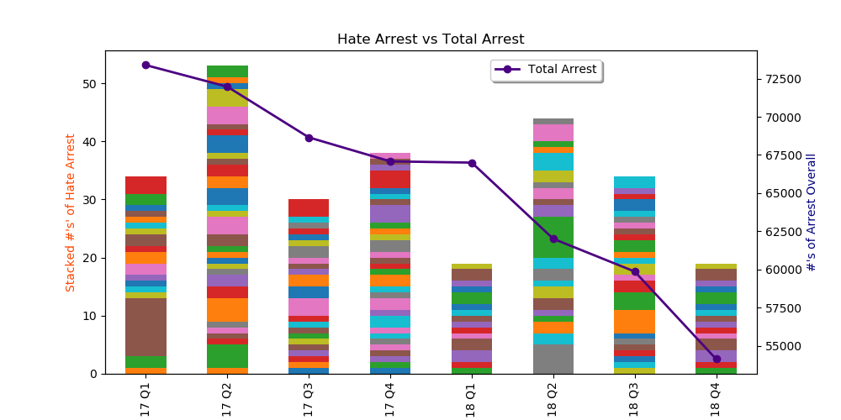
While hate crimes are a spread issue all throughout the U.S. we have been focusing just on NYC
The data analyzed was provided
by the NYPD for total arrest
For the years 2017 - 2018 .
The data was provided by the precinct
In this part of our research we want to see if there is a correlation
Between total crime and hate crime in NYC neighborhoods.
In each NYC precinct we compared total arrests and hate crime
Arrests.
The graph is an overall representation of all the precincts and numbers of hate crime arrest.
Different colors represent different precincts.

Slide 6
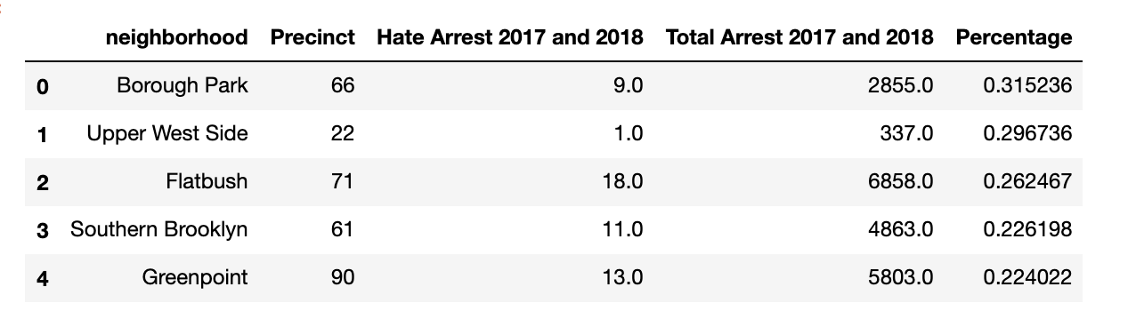
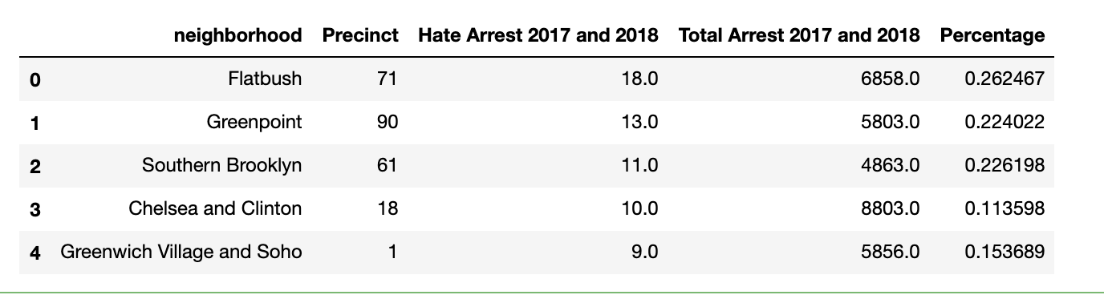
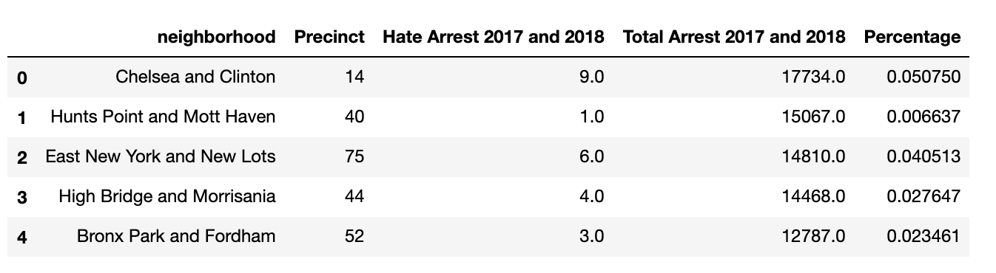
Turns out there’s no correlation between hate crime and total crime rate - some of the safest neighborhoods show a high rate of hate crimes! - on the same page
This table shows top 5 neighborhoods with largest percentage of hate crime committed
( calculated by precinct )
This table shows top 5 neighborhoods
with most hate crimes commited
(calculated by precinct)
top 5 criminal neighbprhoods, with most arrests
(calculated by precinct)

Slide 7
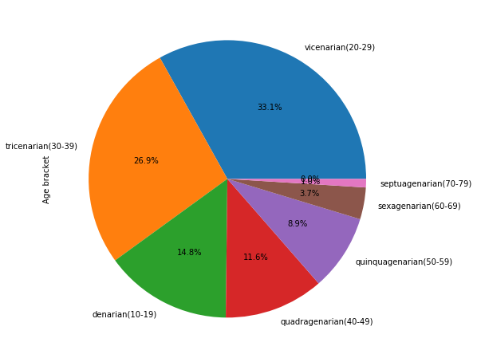
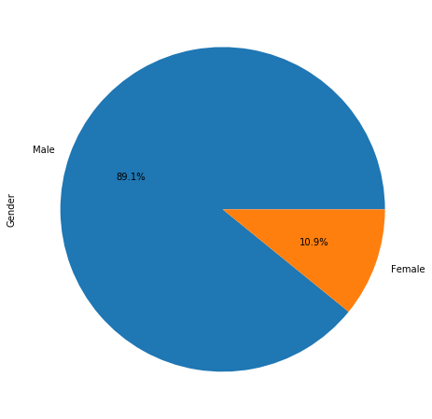
In this part of our analysis we turn our focus on profiling the offenders in NYC data provided by NYPD for the years 2017 - 2018
Offender by age
Offender by gender

Slide 8
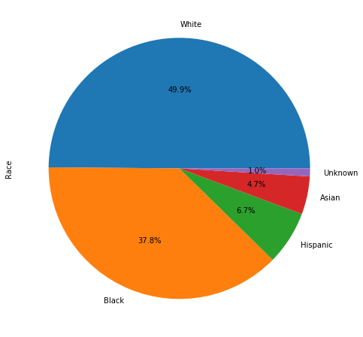
NYC Hate-Crime Committers by Race
While looking true the data from NYPD we found that NYPD is very good in racial profiling of the crime committers.
In NYC we find that most Bias-Motivated crimes are committed by white race in-fact it adds up to half of all crime committers with 49.9%
While the second in line comes black race with a 37.8%, and Hispanic with only 6.7%
And Asian with only 4.7%

Slide 9
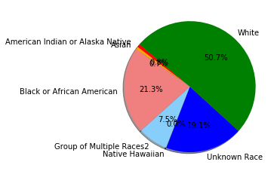
By analyzing data from the FBI we get a little different picture
We get a similar none arguably number of about 50% white but I feel that it is not really clear of the true race of the offenders from this data and there is room for more analysis to get a concrete conclusion on that
Also according the FBI data we find that 8.8%of hate-crimes committers are Hispanic or Latino origin

Slide 10
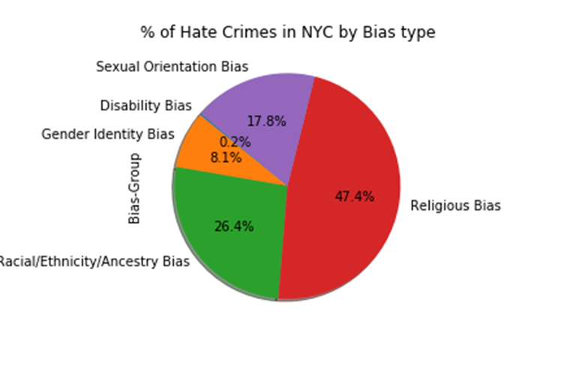
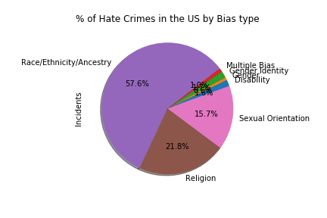
In this part of our representation our focus is on the victims of the Hate-Crime in NYC
As mentioned above, Religion Motivated bias is not an ignorable factor, it’s easier to see it when put in a chart divided by percentage and we can see, it does take up the biggest part of the pie chart with the highest percentage of 47.4%,
while Racial/Ethnicity/Ancestry bias comes in the 2nd biggest with a 26.4%,
3rd is Sexual-Orientation with a 17.8%,
4th comes Gender-Identity with an 8.1%,
And only 0.2% for Disability.
But when compering these numbers with the Federal report we get a different picture, yet still Religious-Linked-bias still comes in the second place with a 21.8% while Racial/Ethnicity/Ancestry bias comes in the 1st biggest with a 57.6%,
Sexual-Orientation 3rd with 15.7
I Think we can soundly lay the fact that Religion and Racial/Ethnicity/Ancestry are going hand in hand with a stark number of 75-80% of all Hate crimes committed in all 50 states in the USA.

Slide 11
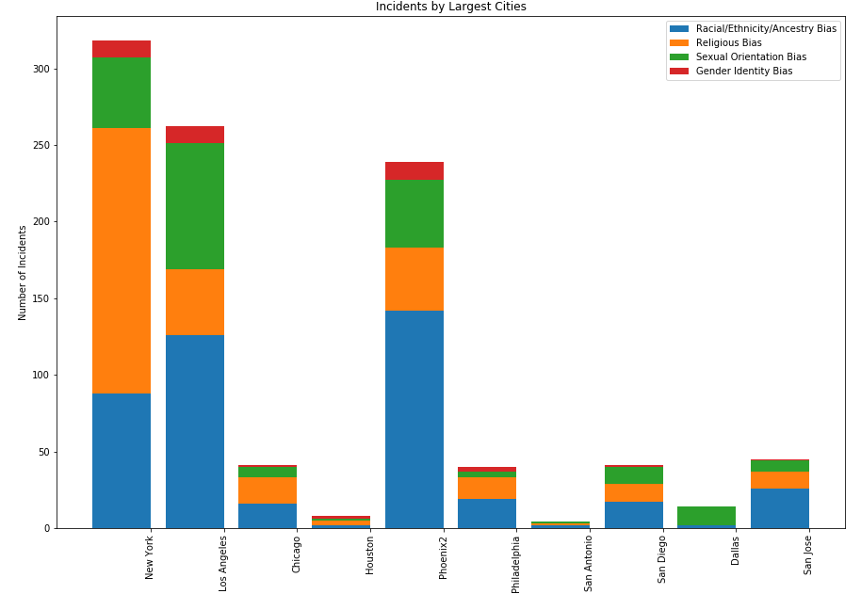
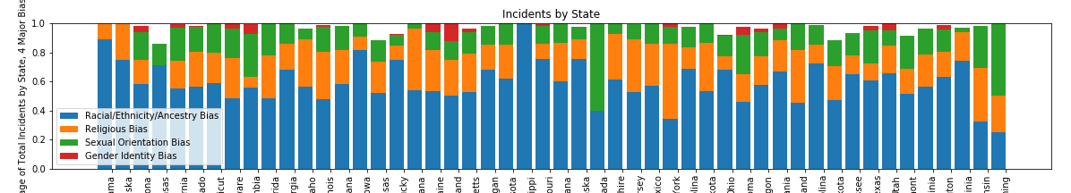
When comparing the the reports of the FBI on 2017 (which by the way thankfully is more divided by the different hate motivations) it shows New York City dominates with the largest amount of religion linked hate-crimes and an incline with a few percent in the last 3 years
Another point to keep in mind is. While Racial-bias dominates in most of the states,
NYS is the only state with a dominating religious bias.

Slide 12
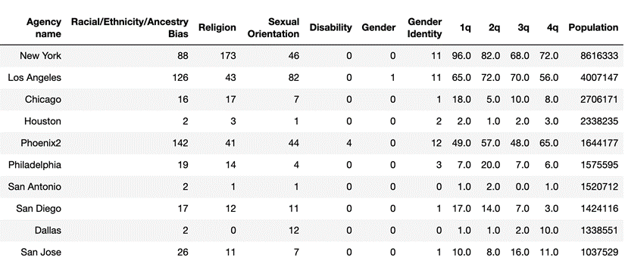
After studying closely the reports by the NYPD on Bias-Motivated arrests in the years 2017 true the second quarter of 2018,
we get a stark picture of Religious, Sexual-Oriented, Ethnicity, Disability and Racial-Motivated bias.
Looking at the greater NYC (all 5 boroughs) we could see Religious linked hate-crimes going through the roof with a staggering number of 173.
To put it in perspective here is a table of the 10 major cities in the us which shows the population vs. the hate crimes.
We have also noticed that NYPD won’t differentiate between the motivations of crimes, but they would rather group them together as just hate crimes.
The most obvious reason is probably to orevent public panic. Thus, we divided them for you, and the picture as you’ll see does not look good for any major city in the closing of the second decades of the second millennium
When we it comes down to comparison of NYC vs. 10 major cities in the US

Slide 13
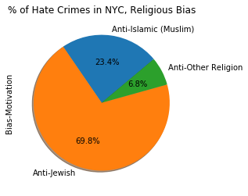
We continue looking closely at Religious-bias-motivation hate crime (using same data provided by NYPD for years 2017 1st q-2019 2nd q)
Most bias related crimes in NYC were committed against Jews [it’s worth mentioning, As of 2014, 1.1 million Jews live in the five boroughs of New York City, and 2 million Jews live in New York State overall. (by Wikipedia)]
At this point we’re assuming that large percentage of Jewish population makes them a greater target vs. other religion communities n the same area.

Slide 14

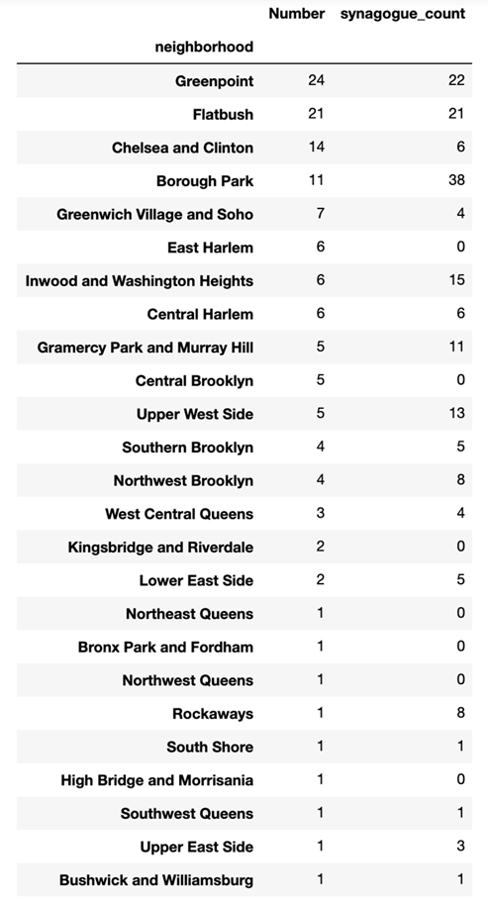
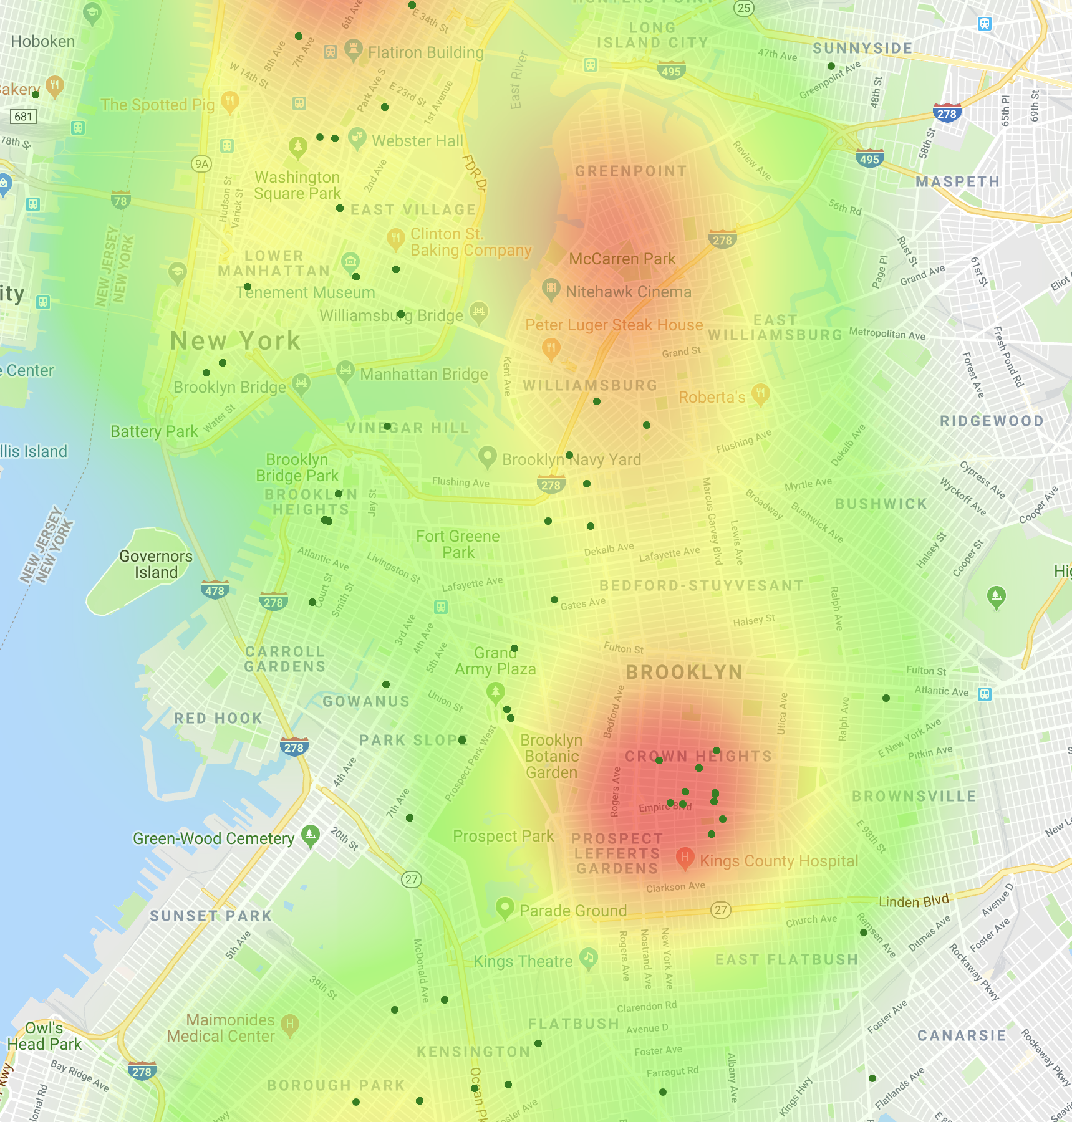
Since bias-crime against Jews are most common, we take a closer look on neighborhoods.
Census data doesn’t provide info on religious centers. Thus, we created a map with known places of worship, aka - Jewish synagogues and Muslim mosques as they are the larger minority communities in the greater NYC, the map concentrates on areas where hate crimes were committed to get estimates of religious population.

Slide 15
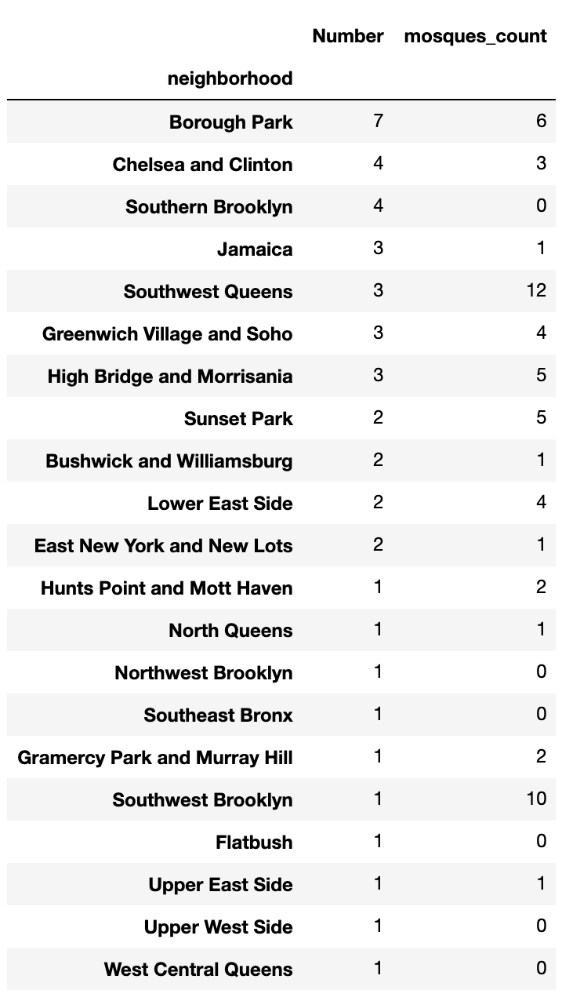
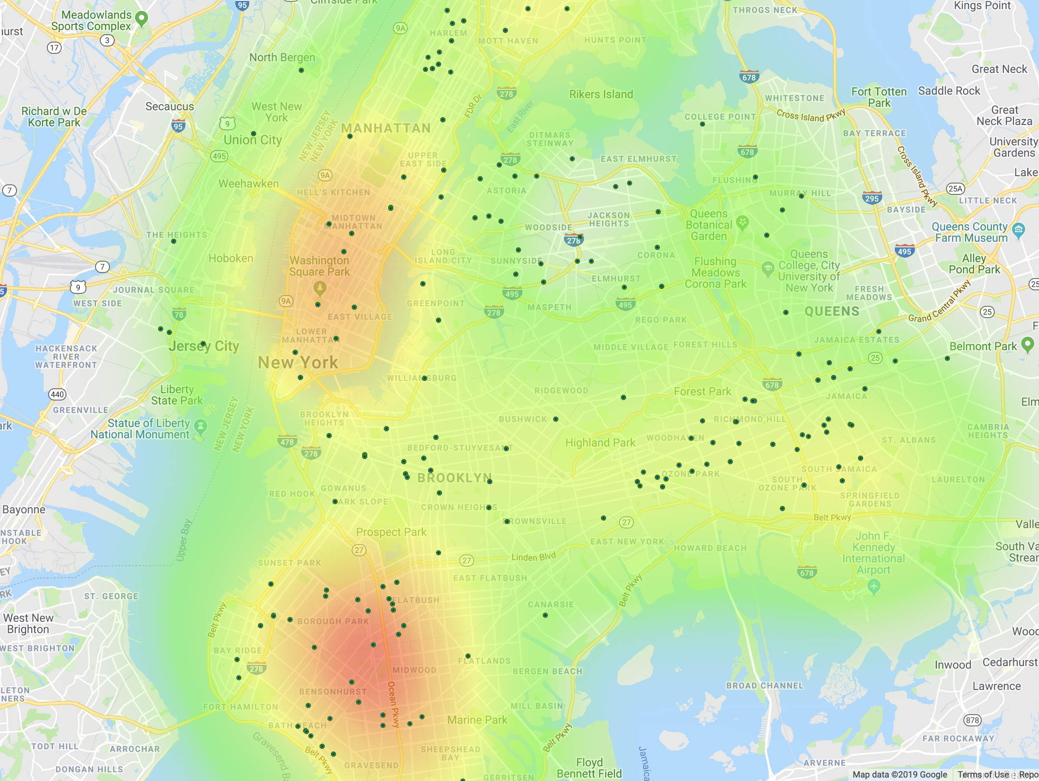
A similar picture of hate crime is when looking at the proportional ratio where there’s a greater number of mosques, it is a safer neighborhood with lower crime rate vs. neighborhoods with less Mosques and higher crime rate overall.
With an exception in the Brooklyn Borough park neighborhood, probability cause, a density of different religious minority groups living close to each other. where no-one particular group is dominating while other safe neighborhoods are usually dominated one minority group
Out of top 5 most hate crime committed there are also top 3 neighborhood with highest number of synagogues. Certain neighborhoods stand out as safe (more synagogues less crime) and certain are more criminal
The same analytical method goes for crimes committed against Muslims by neighborhoods. Above table is a list/count of known mosques spread all around neighborhoods of Brooklyn Queens. Manhattan and south Bronx

Slide 16
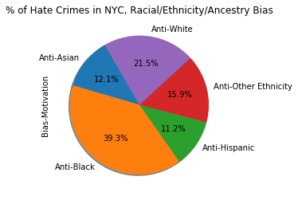
This part is focused on racial bias
The econd most common bias in NYC after religious is racial/ancestry/ethnicity bias.
We want to connect the number of hate crime with the minority population in certain neighborhoods.
We are going to use census data to get the percentage of minority population by zip code.

Slide 17
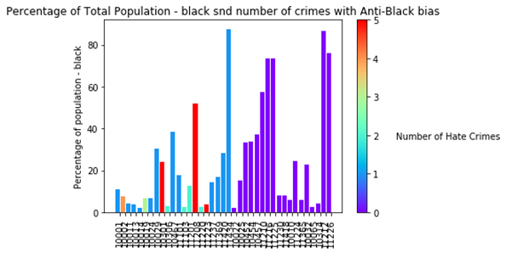
Black population 26% of NYC total.
Turns out Percentage of Black population has no effect on the number of hate crimes with anti-black bias.

Slide 18
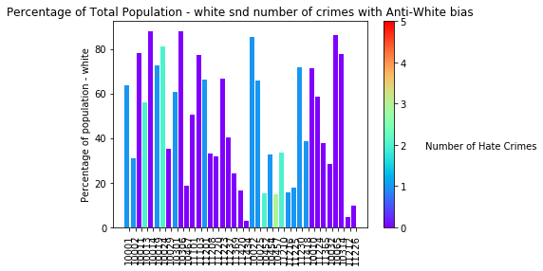
White population 33% of NYC total. No strong correlation, but 3 out of 5 top dangerous zip-codes for whites have white population of less than a third.

Slide 19
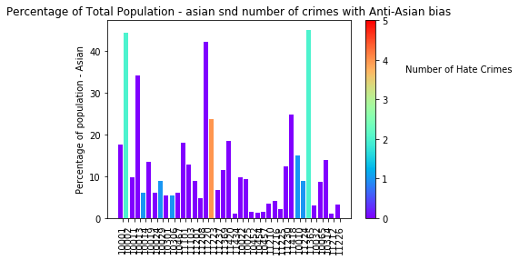
Asian - 13% of NYC population.
Only 12% of racial bias hate crimes fall on Asian population and they peak in zip codes with higher Asian population.

Slide 20
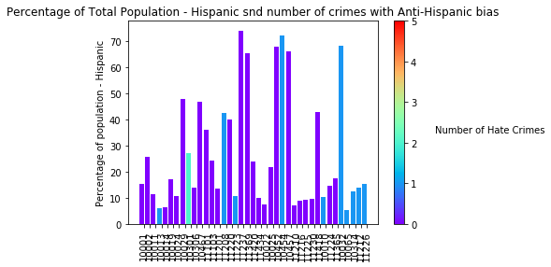
Hispanic 26% of NYC population, no correlation.Conclusion: Racial bias is more spread out and is not concentrated in specific neighborhoods.

Slide 21
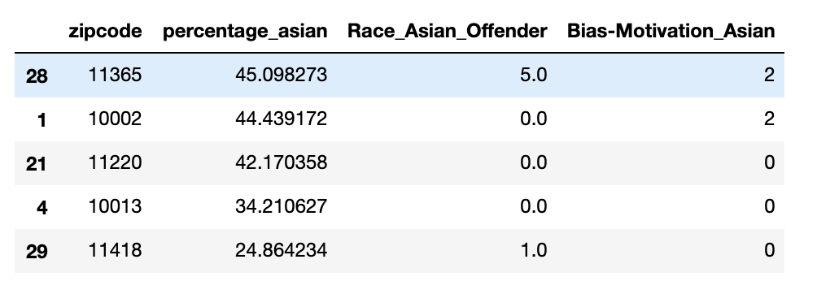

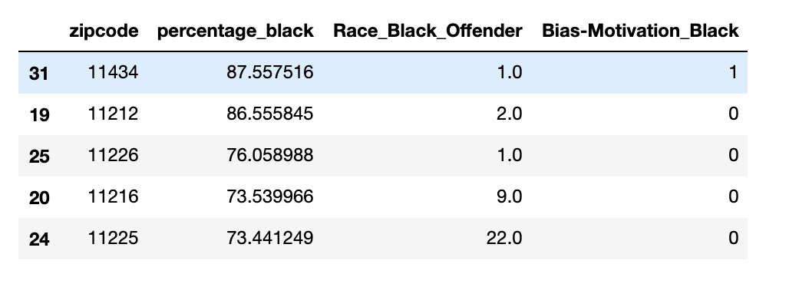
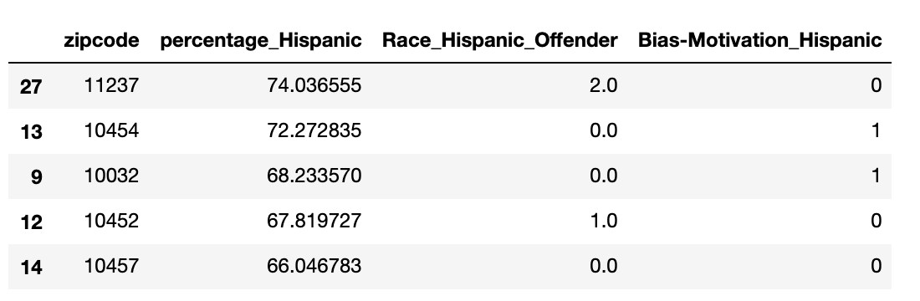
We also tried to see if there is connection between number of crimes and number of criminals by population in each neighborhood. There is only slight correlation for Asian population. It is clear that racial bias is more complex and is not a function of percentage of the population.

Slide 22
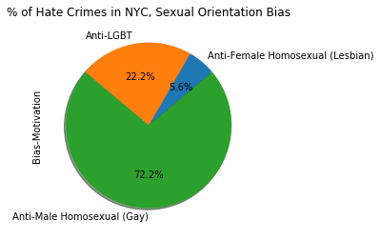
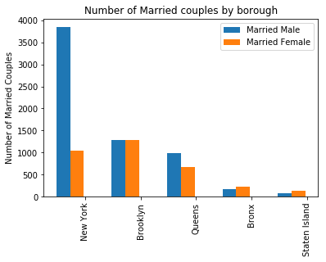
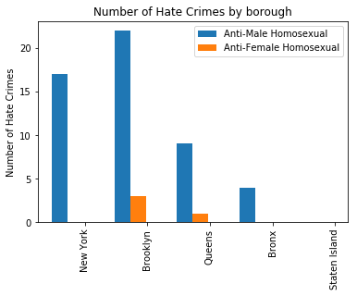
There’s no census data for LGBT population in NYC so we can estimate the population by using Geof Gee, Robin Fisher, and Adam Looney, Joint Filing by Same-Sex Couples after Windsor: Characteristics of Married Tax Filers in 2013 and 2014
LGBT Population by borough:
LGBT Crime by Borough
Seems like crimes against LGBT are disproportionally high in Brooklyn.

Slide 23
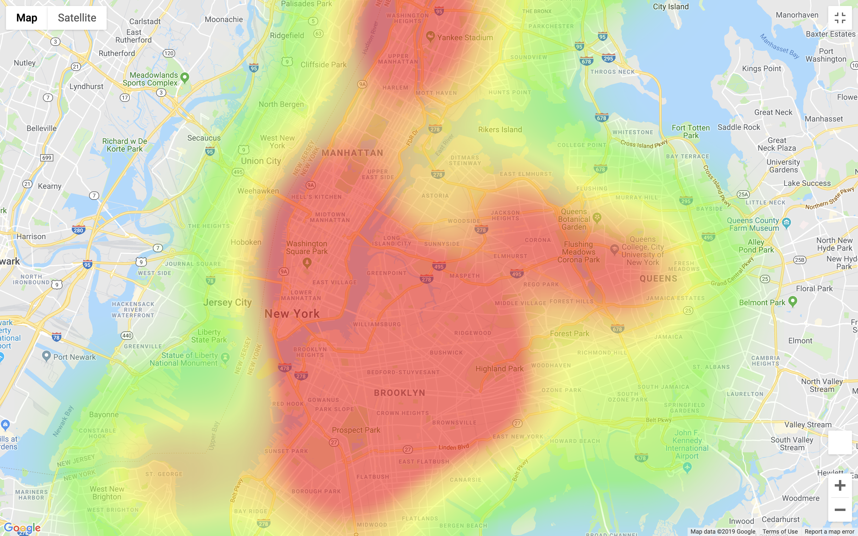
Heat map of crimes against LGBT in NYC:

Slide 24
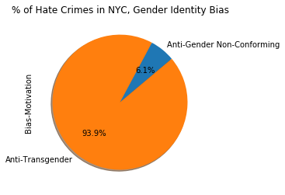
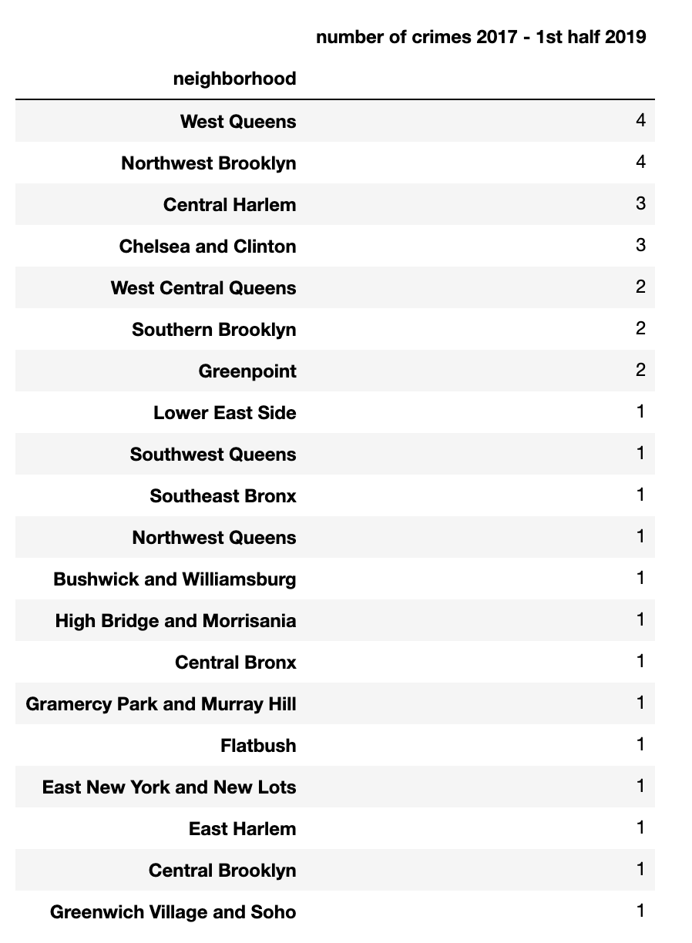
Gender Identity bias makes up 1.7% out of federal hate crime, but 8% of NYC crime. Gender Identity Bias seems to be more present in the large cities. It’s a new bias and we don’t have enough data at this point to analyze it closely by neighborhood.
Mostly against transgender people but also gender non conforming.

